Slide 1
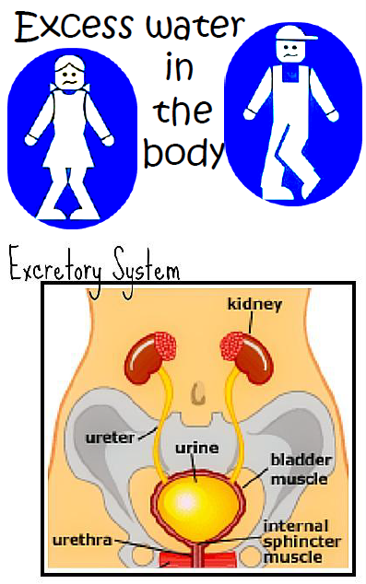

Slide 3
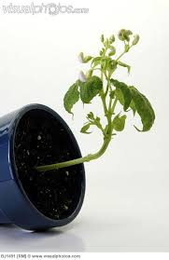
A flower pot is
turned on
its side

Slide 4
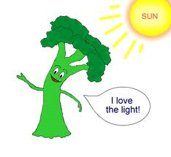
Plant in a dark
room growing
toward a window

Slide 5
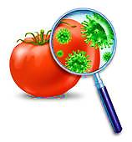
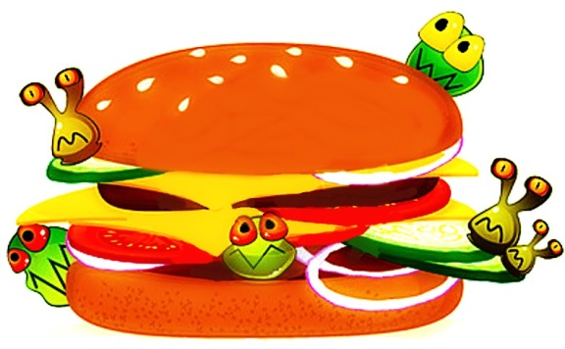
Eating Spoiled
or
Rotten Food
Food

Slide 6
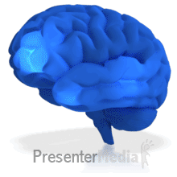
Brain sending a message
that you are thirsty

Slide 7
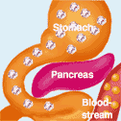
Brain sending a message
that you are hungry

Slide 8
Being Infected
with a
Bacteria or Virus

Slide 9
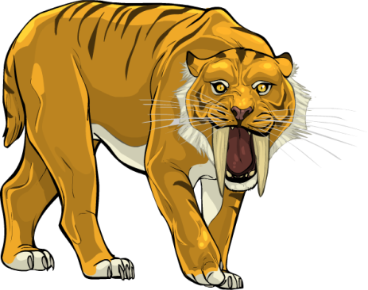
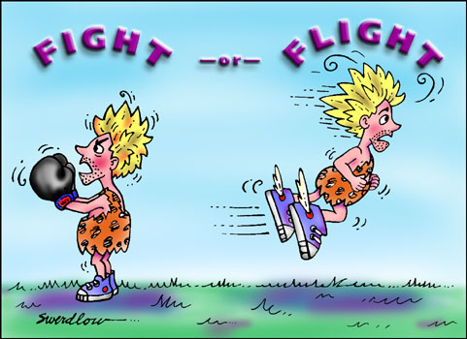
Being Chased by
A Predator

Slide 10
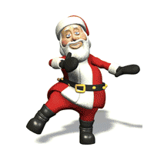
Increased
Exercise

Slide 11
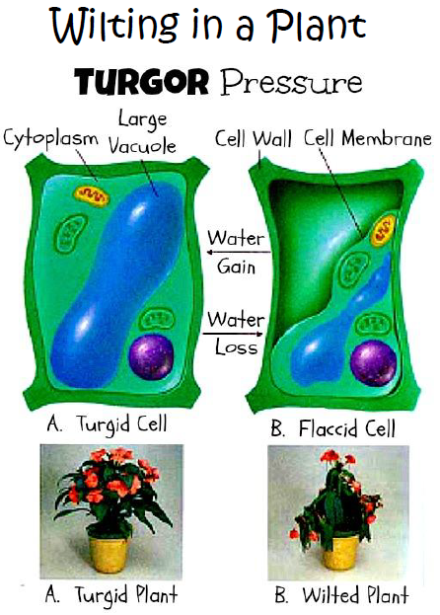

Slide 12
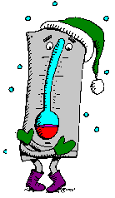
Your body is exposed
to cold weather or
temperature

Slide 13
Your body is exposed to
hot temperatures

