Slide 1
Independent, Dependent, and Control Variables

Slide 2
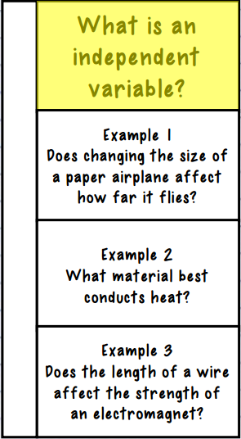
The factor that is being tested; the variable that “I” change during the experiment
Size of the paper airplane
The materials tested
Length of the wire

Slide 3
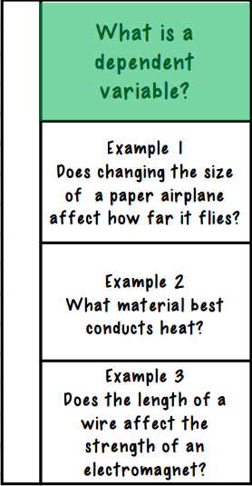
The factor(s) that change based on the independent variable; the prediction or possible results
How far the paper airplane flies
How much heat is conducted
The strength of the electromagnet

Slide 4
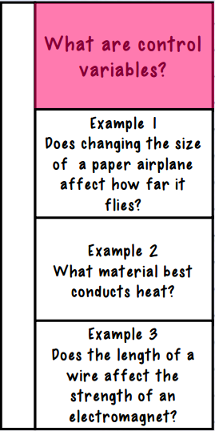
The factors that stay the same/constant
Material of paper, design of plane, force when throwing, wind
Room temperature, amount of materials, heat source
Battery, type of wire

