Slide 1
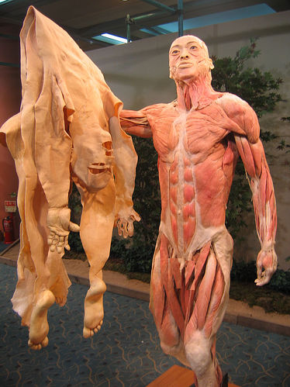
Integumentary System
Function:
The integumentary system:
protects vital organs
senses the environment
excretes waste (perspiration)
produces Vitamin D
regulates body temperature.

Slide 2
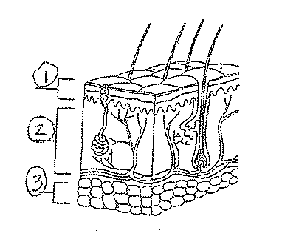
integumentary
System
Structures:
Hair
Skin
Nails
Epidermis
Dermis
Fatty Tissue

Slide 3
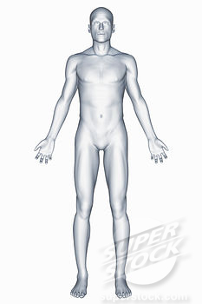
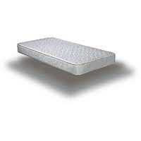
Facts of the Integumentary System
FACT:
The skin is the largest organ on the human body!
Fact:
If an adult’s skin was stretched out, it would cover an area larger than 1.5 square meters or about the size of a twin mattress.

Slide 4
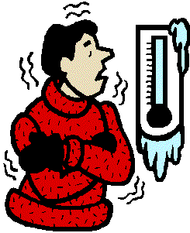
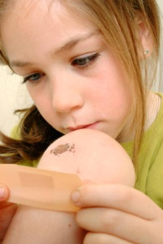
Facts of the Integumentary System
To help maintain homeostasis, the integumentary system responds to many different stimuli:
STIMULUS → RESPONSE
Heat → Sweat
Cold → Shiver
Produces melanin → reduce sun damage
Bleeding → works with platelets to create scabs

