Slide 1
Using a Punnett Square

Slide 2
What is a PUNNETT SQUARE?
A way to show possible genes of offspring
A chart that shows all the possible combinations of alleles that can result when genes are crossed

Slide 3
What is a PUNNETT SQUARE?
A tool to predict the probability of certain traits in offspring that shows the different ways alleles can combine
Offspring have two alleles for each trait
Offspring get one allele for each trait from each parent

Slide 4
What is a PUNNETT SQUARE?
A way to show phenotype & genotype
Phenotype- Physical trait that you can observe
Example: Purple Flower
Genotype- The alleles that show a trait, the two letters.
Example: PP
WRITE THIS DOWN TOO!

Slide 5
Using a PUNNETT SQUARE
Gregor Mendel is the father of Genetics
He discovered the Law of Dominance which says that alleles are either dominant or recessive.
Video: https://www.youtube.com/watch?v=Mehz7tCxjSE

Slide 6
What is a PUNNETT SQUARE?
Letters stand for dominant and recessive alleles
An uppercase letter stands for a dominant allele
Dominant Alleles will always show up in the phenotype
Example: P …the purple trait
Lowercase letters stand for recessive alleles
Recessive alleles will be expressed in the phenotype ONLY if it is with another recessive allele.
Example: p …the white trait

Slide 7
Using a PUNNETT SQUARE
To set up a Punnett square, draw a large square, and then divide it into 4 equal sections (also squares). It should look something like this:

Slide 8
Using a PUNNETT SQUARE
Now you need two parents to mate, ones with a known genotype
For example, a red flower (genotype Rr) and a white flower (genotype rr). Rr x rr

Slide 9
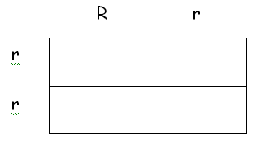
Using a PUNNETT SQUARE
Place one of the parents on top, and one on the left. You should get a something similar to this:

Slide 10
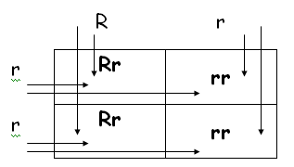
Using a PUNNETT SQUARE
Finally, take each letter in each column and combine it with each letter from each row in the corresponding square. You should now have a picture close to this:

Slide 11
Using a PUNNETT SQUARE
The possible genotypes of offspring are: Rr, Rr, rr, and rr genotypes
From this it is possible to determine the probability (chance) that a flower will have a red phenotype (2/4 or 50%) or a white phenotype (2/4 or 50%)

Slide 12
Using a PUNNETT SQUARE
RR is dominant Homozygous
Rr is dominant Heterozygous
rr is recessive Homozygous
Frame and Name!
HOMO -
HETERO-

Slide 13
Using a PUNNETT SQUARE
HOMO ZYGOUS= Purebred
HETEROZYGOUS= Hybrid

